Slide 1
Data Curation
Dr Mehreen Alam

Slide 2
Contents
Data Curation:
Data Gathering
Organization
Cleaning
Enrichment
Labeling
Validation
Stewardship
Big Datasets

Slide 3
1 - Data Gathering
Collecting raw data
Web scraping
Recordings
Logging

Slide 4
2 - Organization
Structured
Unstructured

Slide 5
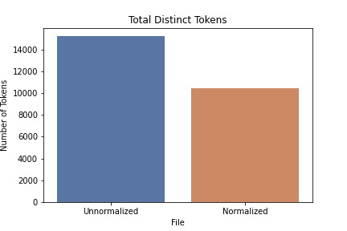
3 - Cleaning
Normalization
Anomaly detection
Outlier removal
Garbage data

Slide 6
3a - Normalization
Removal of duplicate whitespaces and punctuation.
Accent removal (if your data includes diacritical marks from ‘foreign’ languages — this helps to reduce errors related to encoding type).
Capital letter removal, they are very important to extract information, like names and locations.
Removal or substitution of special characters/emojis (e.g.: remove hashtags).
Substitution of contractions (very common in English; e.g.: ‘I’m’→‘I am’).
Transform word numerals into numbers (eg.: ‘twenty three’→‘23’).
Substitution of values for their type (e.g.: ‘$50’→‘MONEY’).

Slide 7
3a - Normalization
Acronym normalization (e.g.: ‘US’→‘United States’/‘U.S.A’) and abbreviation normalization (e.g.: ‘btw’→‘by the way’).
Normalize date formats, social security numbers or other data that have a standard format.
Spell correction
Removal of gender/time/grade variation with Stemming or Lemmatization.
Substitution of rare words for more common synonyms.
Stop word removal

Slide 8
4 - Enrichment
Filling missing values
Augmentation
Fusion
Balancing, representation
Adjustment (remove biases)

Slide 9
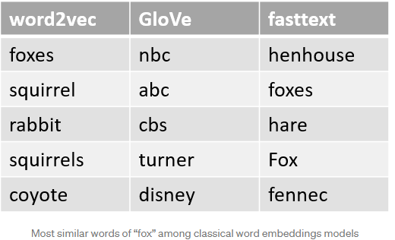
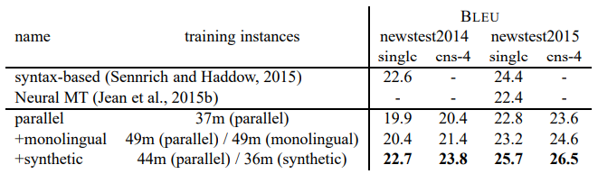
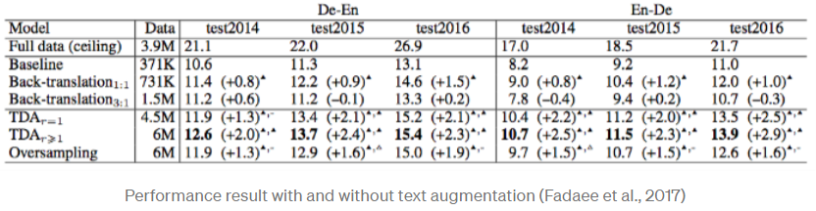
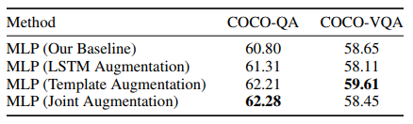
4a - Augmentation: Text
Thesaurus
Words and phrases with their synonyms
Word Embeddings
k-nearest neighbor, cosine similarity
Back Translation
Contextualized Word Embeddings
Text Generation

Slide 10
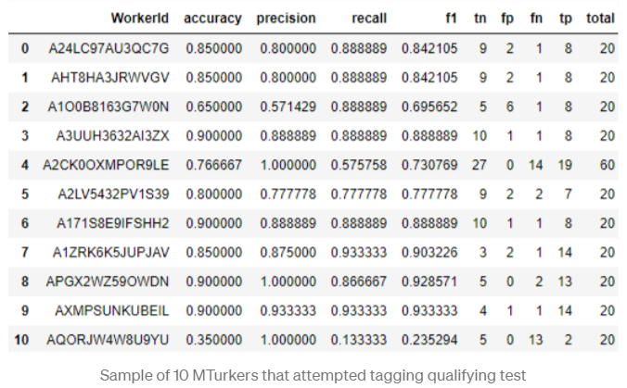
5 - Labeling
manual labeling
crowd-sourcing
IIA
inter-annotator agreement
Fleiss Kappa

Slide 11
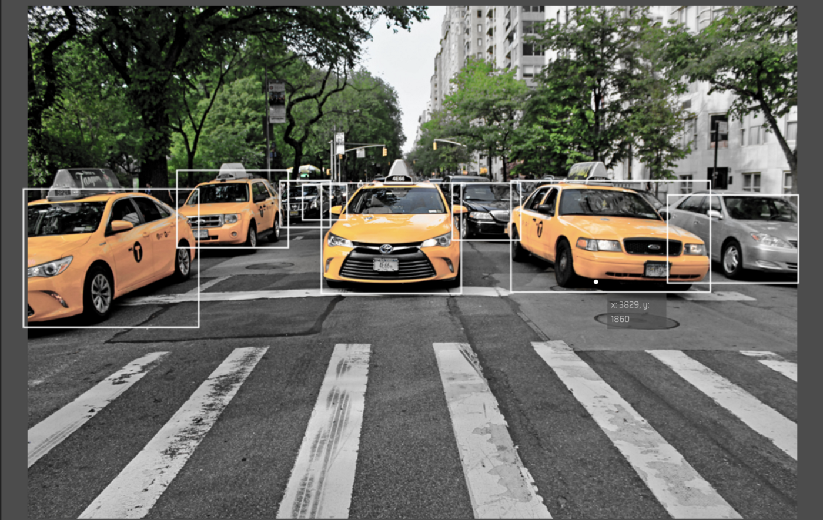
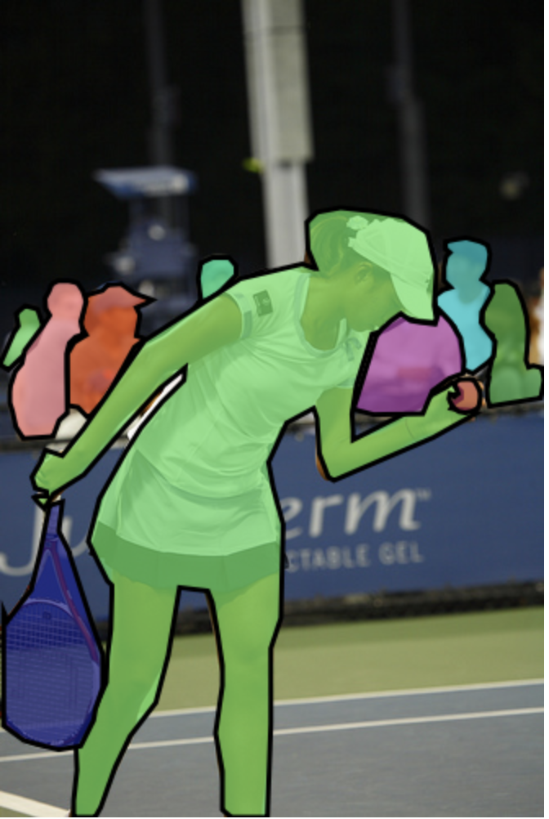
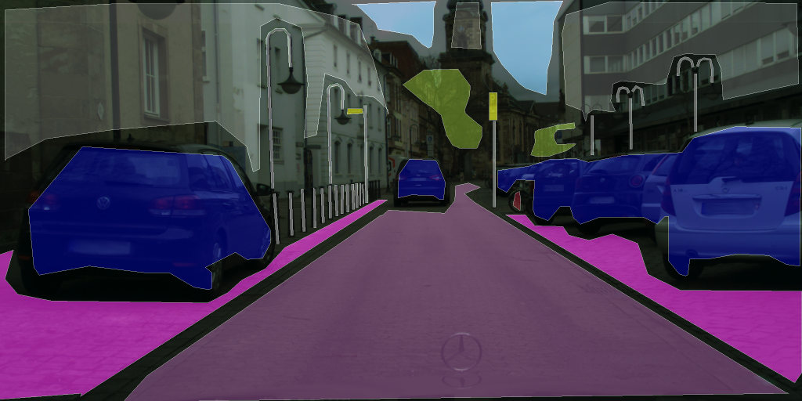
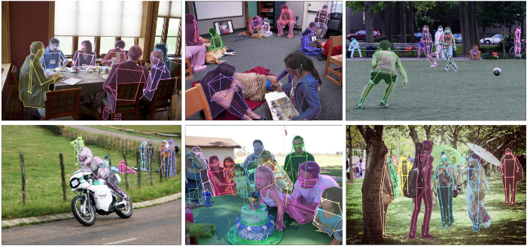
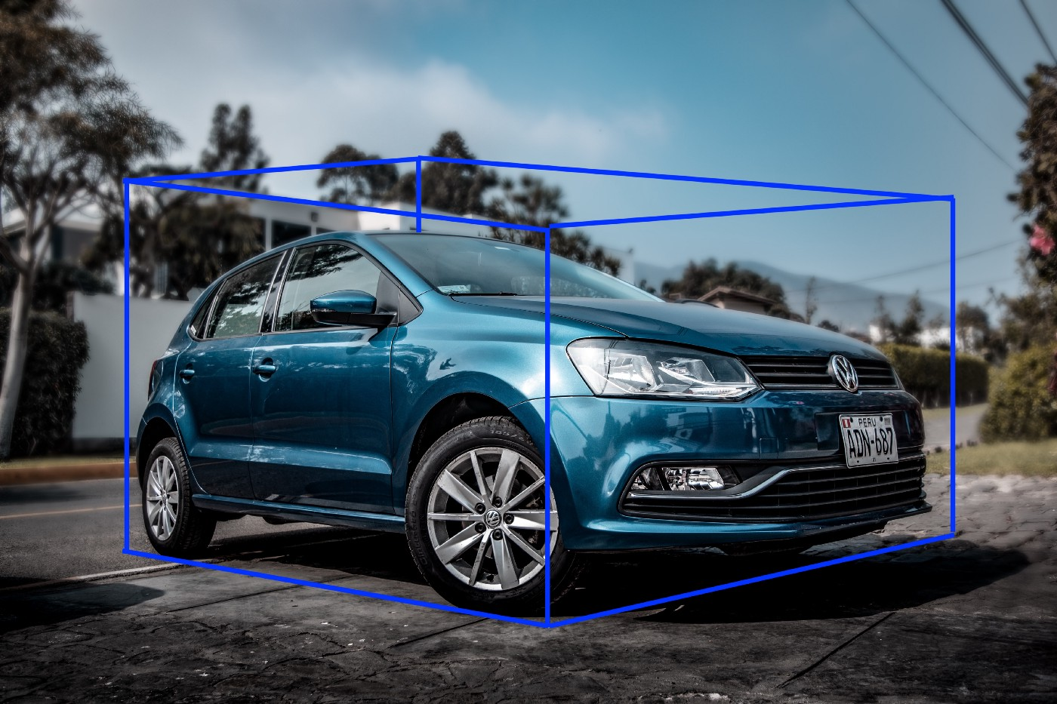

5a - Annotation/Labelling
Bounding boxes
Polygonal segmentation
Semantic segmentation
3D cuboids
Key-Point and Landmark
Lines and Splines

Slide 12
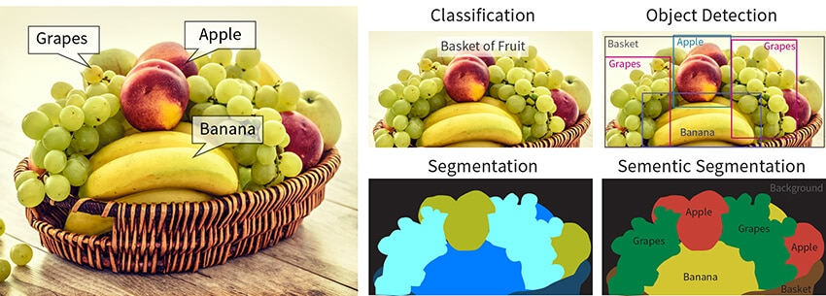

Slide 13
5 - Labeling
AMT
CrowdFlower
LabelBox
scaleAI

Slide 14
6 - Validation
Correctness and consistency
Quality
Coverage and completeness
Expert evaluation

Slide 15
7 - Stewardship
Addition of metadata
Ensuring security
Custodianship
Licensing/distribution/publishing

Slide 16
Big Datasets
Meta
Alphabet
FB #10YearChallenge
reCAPTCHA
Cambridge Analytica
Twitter Hashtags

Slide 17
Useful Links
https://towardsdatascience.com/text-normalization-7ecc8e084e31
https://towardsdatascience.com/data-augmentation-in-nlp-2801a34dfc28
https://towardsdatascience.com/image-data-labelling-and-annotation-everything-you-need-to-know-86ede6c684b1

